Slide 1

Skin Cancer Binary Classifier
By
Muhammad Ashar Javid
Awais Asghar
Ammer Saeed
Wassi Haider Kabir

Slide 2

Exploratory Data Analysis

Slide 3

Data Loading
• Load the dataset, including images and metadata.
• Ensure images are read and preprocessed correctly, with file paths accurately linked to labels.
• Verify the integration of all data sources for a comprehensive dataset.
• Conduct an initial check for data integrity issues, addressing missing files or incorrect labels.

Slide 4

Data Visualization
• Visualize a random sample of images to assess their quality and characteristics.
• Plot the distribution of malignant and benign cases to evaluate dataset balance.
• Optionally, visualize metadata such as patient age or lesion location for additional insights.

Slide 5

Statistical Analysis
• Calculate basic statistics for image dimensions, including mean and standard deviation.
• Analyze metadata for insights like patient age and lesion location.
• Explore correlations between metadata features and image labels.

Slide 6

Class Distribution
• Check for class imbalance between malignant and benign lesions.
• Visualize class distribution using bar charts or pie charts.
• Plan strategies to address any identified class imbalance.

Slide 7

Preprocessing

Slide 8

Data Cleaning
Remove duplicates and errors.
Handle missing values appropriately.
Standardize data formats.
Data Augmentation
Apply random transformations (rotation, flip).
Adjust brightness, contrast, and saturation.
Generate synthetic data samples.

Slide 9

Image Normalization
Scale pixel values to a specific range.
Adjust for mean and variance.
Normalize across all images consistently.
Resizing and Cropping
Resize images to a fixed dimension.
Crop images to remove irrelevant areas.
Maintain aspect ratio during resizing.

Slide 10
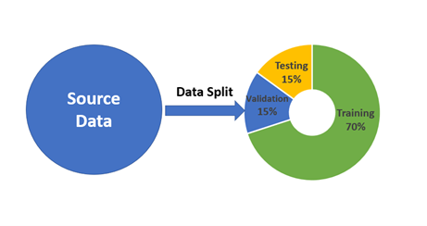
Data Splitting

Slide 11

Model Selection
• XGBoost: Robust for regression tasks, handles large datasets.
• AdaBoost: Boosts weak learners, effective for classification.
• LGBM Classifier: Fast gradient boosting, high accuracy.
• SVM: Effective for high-dimensional data, versatile kernels.
• Logistic Regression: Simple yet effective for binary classification.

Slide 12

Model training
Hyperparameter Tuning: Optimize parameters with grid search, random search, or Bayesian optimization.
Cross-Validation: Employ k-fold cross-validation for model robustness and generalizability.
XGBoost Training: Adjust learning rate, maximum depth, and number of estimators.
SVM Training: Tune regularization parameter (C) and kernel parameters.
Neural Network Training: Define architecture, activation functions, and optimizer.

Slide 13

Model Evaluation
Performance Metrics: Use accuracy, precision, recall, F1-score, and AUC for comprehensive evaluation.
Validation Set: Monitor validation set performance to avoid overfitting.
Confusion Matrix: Analyze error types and model performance through the confusion matrix.

Slide 14
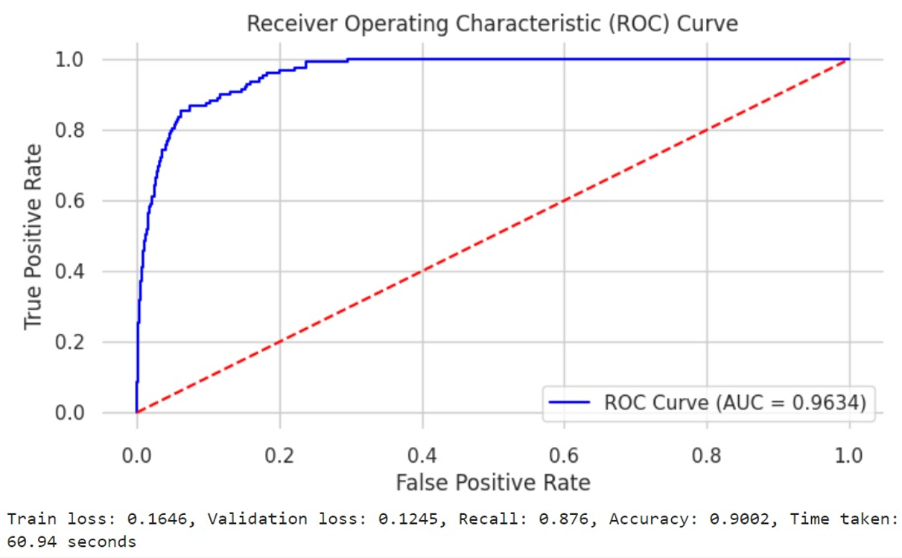
Results

Slide 15


